Slide 1
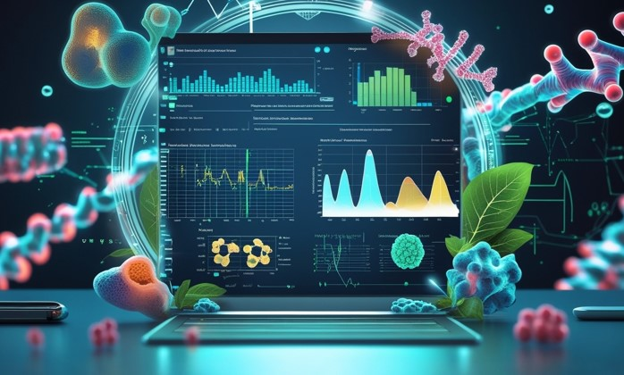
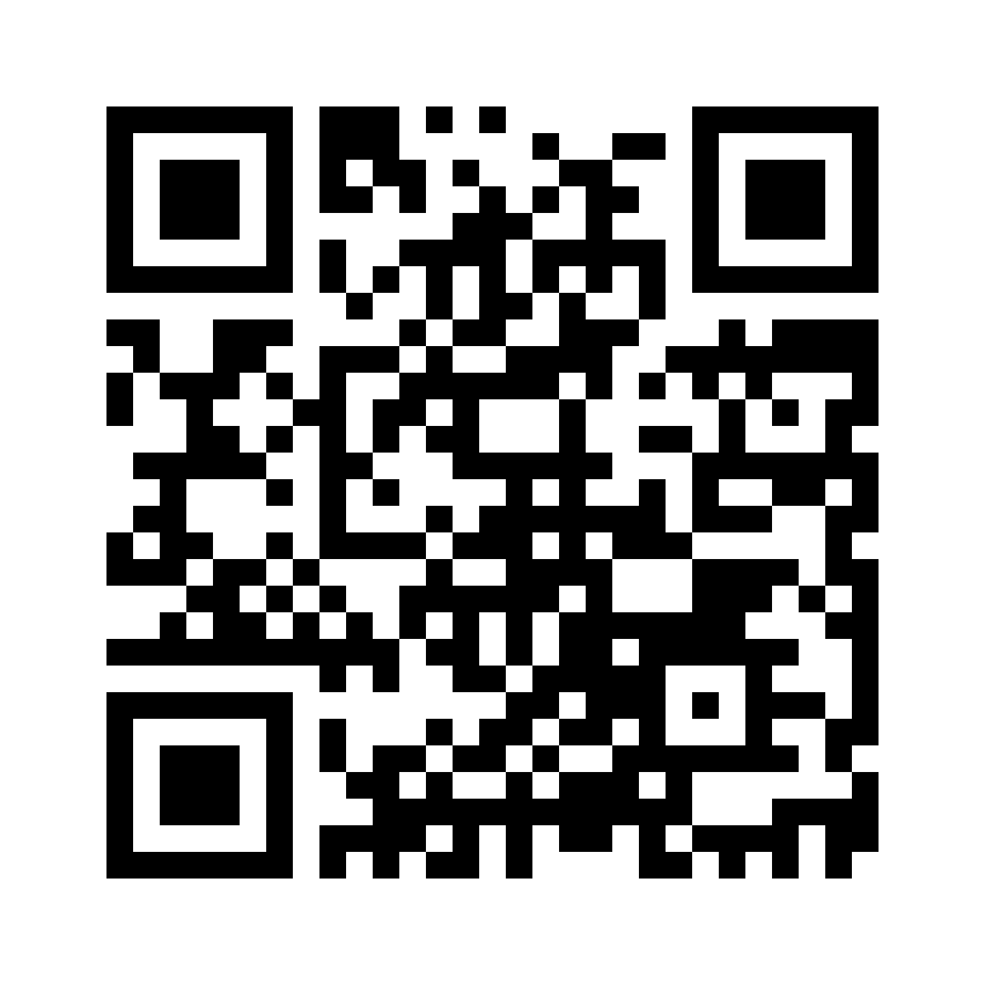
Introduction to Biostatistics & Machine Learning Short course
©️ Olga Dethlefsen
A national course open to PhD students, researchers, and other staff from Swedish universities and the life science industry who analyze research data.
Apply by 14 March 2025!
7 – 11 April 2025
Uppsala Biomedical Centre, Uppsala, Sweden
For more information and registration

